Slide 1


Delaxshana Santhiravathanan
16/05/2023

Slide 2

Outline
Executive Summary
Introduction
Methodology
Results
Conclusion
Appendix

Slide 3
Executive Summary
Summary of methodologies
collecting data
Wrangling data
EDA data visualization and sql handling
Building map and dashboard
Predictive analysis
Summary of all results
EDA result
Interactive analytics
Predictive analytics

Slide 4
Introduction
Project background and context
SpaceX launches
Problems you want to find answers

Slide 5

Section 1

Slide 6
Methodology
Executive Summary
Data collection methodology:
Web sc
SpaceX rest API
Perform data wrangling
One hot encoding data fields and cleaning data by cleaning null values and irrevalant columns
Perform exploratory data analysis (EDA) using visualization and SQL
Perform interactive visual analytics using Folium and Plotly Dash
Perform predictive analysis using classification models
KNN, SVM, DT models

Slide 7
Data Collection
Describe how data sets were collected.
Launch the data which is gathered from SpaceX rest api
API will produce the data about launch history such as used rockets, launch specifications, outcomes
The URL for the api is https://api.spacexdata.com/v4/launches/past
Next data source for falcon 9 launch data is web scraping using beautifulsoup

Slide 8
Data Collection – SpaceX API
Present your data collection with SpaceX REST calls using key phrases and flowcharts
Getting response from API ->
convert response to json ->
apply functions to cleaned data ->
Assign dictoneries to data frame ->
filter data and export them to flat file
Add the GitHub URL of the completed SpaceX API calls notebook (must include completed code cell and outcome cell), as an external reference and peer-review purpose
https://github.com/Delaxshana/-IBM-data-analyst-capstone-project/blob/main/data%20collection%20using%20url.ipynb

Slide 9
Data Collection - Scraping
Present your web scraping process using key phrases and flowcharts
Getting response from HTML ->
Creating beautifulsoap object ->
Finding table ->
Getting column details ->
Appending data to keys ->
Dataframe converted to flat file
Add the GitHub URL of the completed web scraping notebook, as an external reference and peer-review purpose
https://github.com/Delaxshana/-IBM-data-analyst-capstone-project/blob/main/data%20collection%20using%20web%20scrapping.ipynb

Slide 10
Data Wrangling
EDA Analysis
Check null values ->
calculate the number of launches in each site ->
Calculate the number and occurance of each orbit - >
Calculate the number and occurance of mission outcome per orbit type ->
Create a landing outcome label from outcome column - >
Handle null values
https://github.com/Delaxshana/-IBM-data-analyst-capstone-project/blob/main/Data%20Wrangling.ipynb

Slide 11
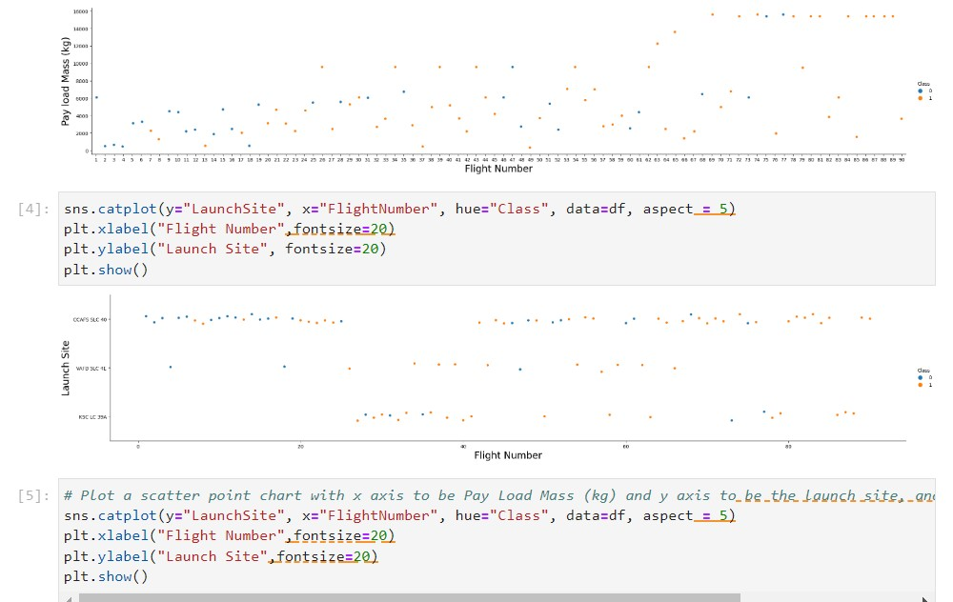
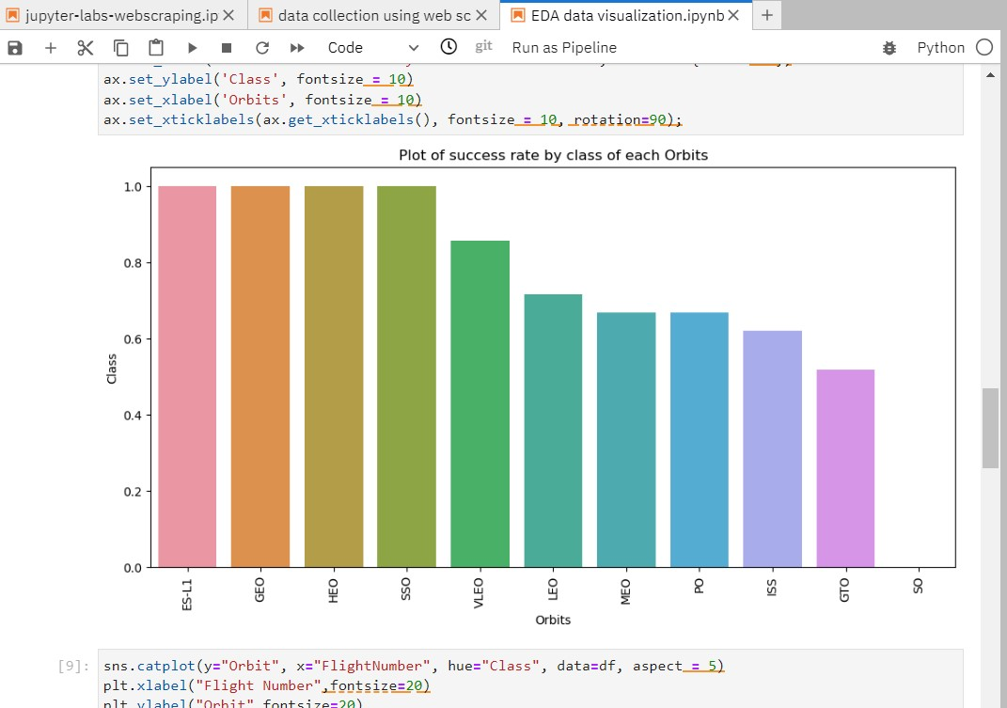
EDA with Data Visualization
https://github.com/Delaxshana/-IBM-data-analyst-capstone-project/blob/main/EDA%20data%20visualization.ipynb

Slide 12
EDA with SQL
Executed the queries to get the response from the database created
Display the names of the unique launch sites in the space mission
Display 5 records where launch sites begin with the string 'CCA'
Display the total payload mass carried by boosters launched by NASA (CRS)
Display average payload mass carried by booster version F9 v1.1
List the date when the first successful landing outcome in ground pad was acheived.
List the total number of successful and failure mission outcomes
List the failed landing_outcomes in drone ship, their booster versions, and launch site names for in year 2015
https://github.com/Delaxshana/-IBM-data-analyst-capstone-project/blob/main/EDA%20with%20SQL.ipynb

Slide 13
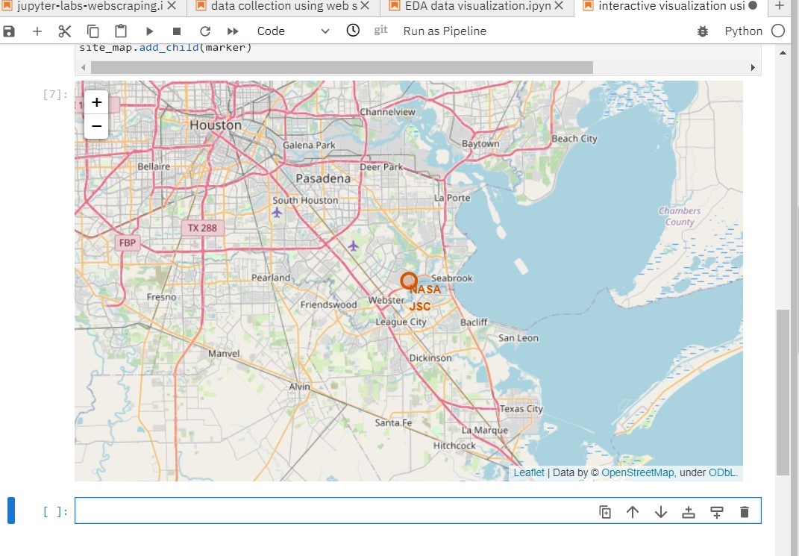
Build an Interactive Map with Folium
https://github.com/Delaxshana/-IBM-data-analyst-capstone-project/blob/main/interactive%20visualization%20using%20foilum.ipynb

Slide 14
Build a Dashboard with Plotly Dash
calculated the distances between a launch site to its proximities. We answered some question for instance:
Are launch sites near railways, highways and coastlines.
Do launch sites keep certain distance away from cities.
https://github.com/Delaxshana/-IBM-data-analyst-capstone-project/blob/main/dashboard%20using%20fplotly.ipynb

Slide 15


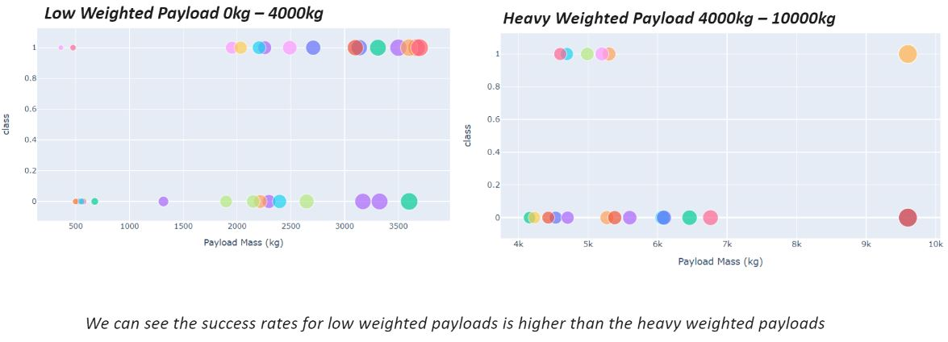

Slide 16
Predictive Analysis (Classification)
https://github.com/Delaxshana/-IBM-data-analyst-capstone-project/blob/main/prediction%20for%20machine%20learning.ipynb

Slide 17
Results
Exploratory data analysis results
Interactive analytics demo in screenshots
Predictive analysis results

Slide 18

Section 2

Slide 19
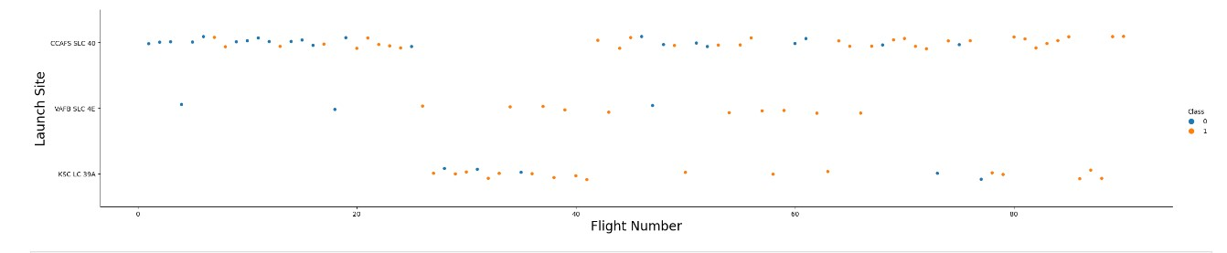
Flight Number vs. Launch Site

Slide 20
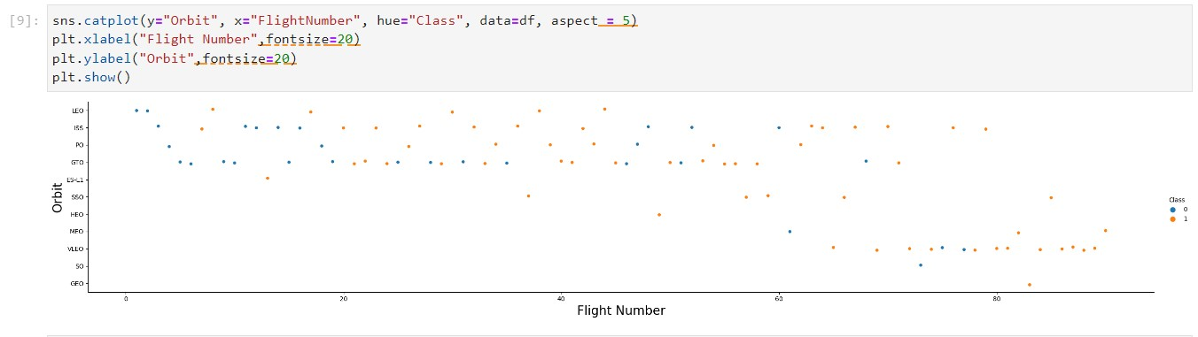
Payload vs. Launch Site

Slide 21
Success Rate vs. Orbit Type
From the plot, we can see that ES-L1, GEO, HEO, SSO, VLEO had the most success rate and the lease success rate among these types is GTO

Slide 22
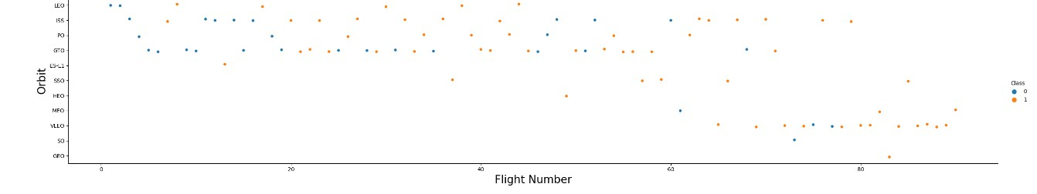
Flight Number vs. Orbit Type
The plot below shows the Flight Number vs. Orbit type. We observe that in the LEO orbit, success is related to the number of flights whereas in the GTO orbit, there is no relationship between flight number and the orbit.

Slide 23
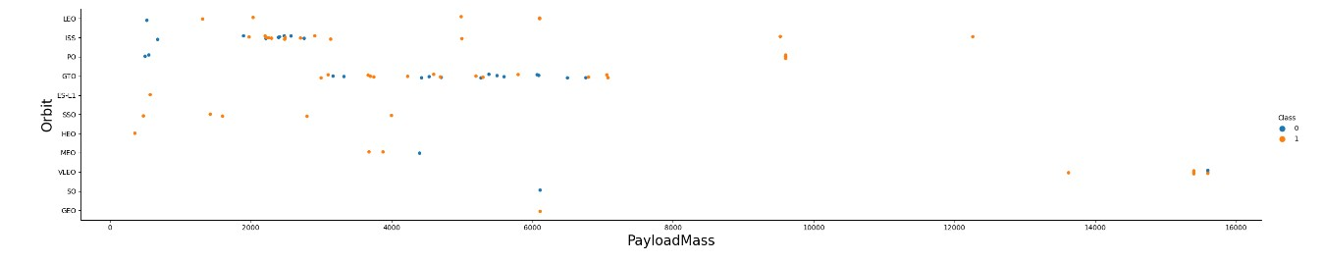
Payload vs. Orbit Type

Slide 24
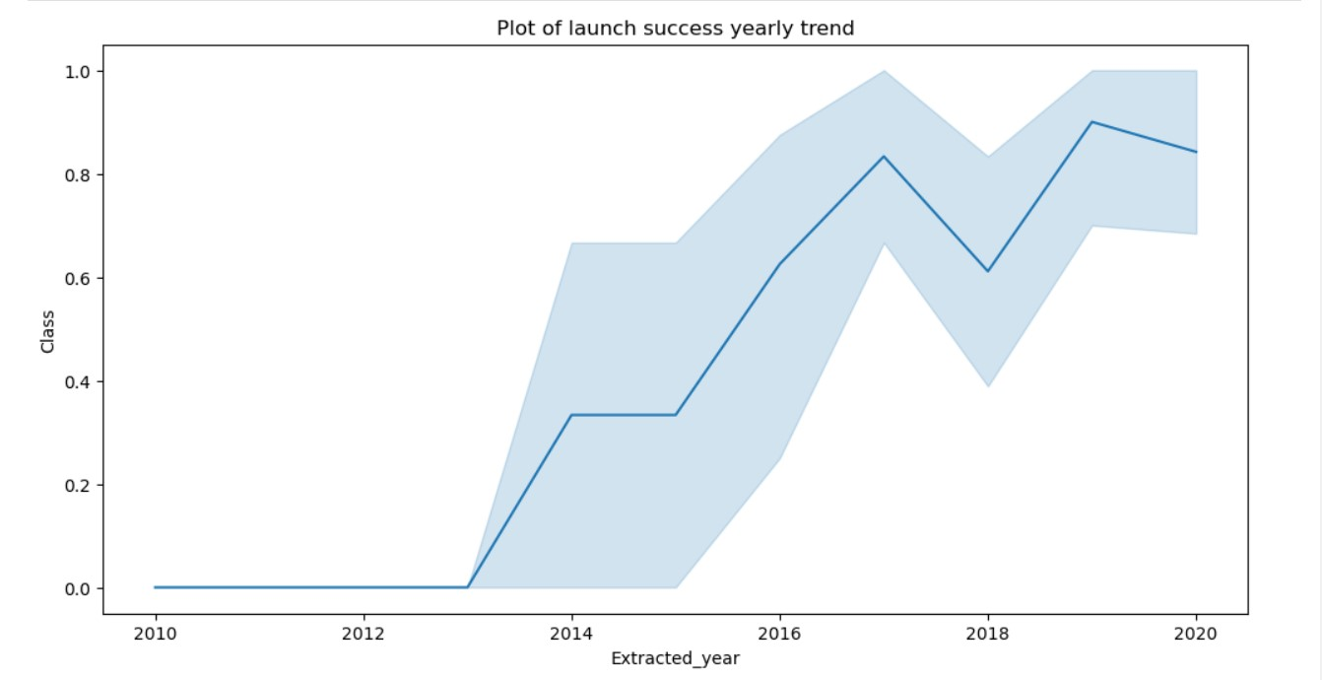
Launch Success Yearly Trend

Slide 25

All Launch Site Names
We used the key word DISTINCT to show only unique launch sites from the SpaceX data.

Slide 26

Launch Site Names Begin with 'CCA'

Slide 27
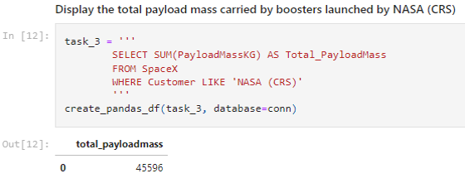
Total Payload Mass

Slide 28
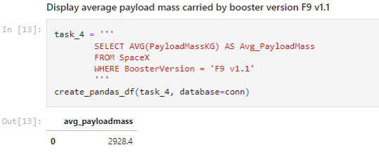
Average Payload Mass by F9 v1.1
Calculate the average payload mass carried by booster version F9 v1.1
Present your query result with a short explanation here

Slide 29

First Successful Ground Landing Date

Slide 30
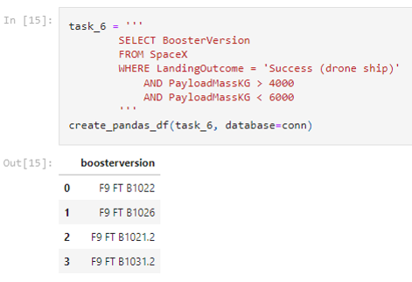
Successful Drone Ship Landing with Payload between 4000 and 6000

Slide 31

Total Number of Successful and Failure Mission Outcomes

Slide 32

Boosters Carried Maximum Payload

Slide 33

2015 Launch Records

Slide 34
Rank Landing Outcomes Between 2010-06-04 and 2017-03-20
Rank the count of landing outcomes (such as Failure (drone ship) or Success (ground pad)) between the date 2010-06-04 and 2017-03-20, in descending order
Present your query result with a short explanation here

Slide 35

Section 3

Slide 36
<Folium Map Screenshot 1>
Replace <Folium map screenshot 1> title with an appropriate title
Explore the generated folium map and make a proper screenshot to include all launch sites’ location markers on a global map
Explain the important elements and findings on the screenshot

Slide 37
<Folium Map Screenshot 2>
Replace <Folium map screenshot 2> title with an appropriate title
Explore the folium map and make a proper screenshot to show the color-labeled launch outcomes on the map
Explain the important elements and findings on the screenshot

Slide 38
<Folium Map Screenshot 3>
Replace <Folium map screenshot 3> title with an appropriate title
Explore the generated folium map and show the screenshot of a selected launch site to its proximities such as railway, highway, coastline, with distance calculated and displayed
Explain the important elements and findings on the screenshot

Slide 39

Section 4

Slide 40

<Dashboard Screenshot 1>

Slide 41
<Dashboard Screenshot 3>
Replace <Dashboard screenshot 3> title with an appropriate title
Show screenshots of Payload vs. Launch Outcome scatter plot for all sites, with different payload selected in the range slider
Explain the important elements and findings on the screenshot, such as which payload range or booster version have the largest success rate, etc.

Slide 42

Section 5

Slide 43

Classification Accuracy

Slide 44
Conclusions
We can conclude that:
The larger the flight amount at a launch site, the greater the success rate at a launch site.
Launch success rate started to increase in 2013 till 2020.
Orbits ES-L1, GEO, HEO, SSO, VLEO had the most success rate.
KSC LC-39A had the most successful launches of any sites.
The Decision tree classifier is the best machine learning algorithm for this task.

Slide 45
Appendix
Include any relevant assets like Python code snippets, SQL queries, charts, Notebook outputs, or data sets that you may have created during this project
https://github.com/Delaxshana/-IBM-data-analyst-capstone-project

Slide 46


